Slide 1
Azure Infrastructure as a Services (IaaS)

Slide 2

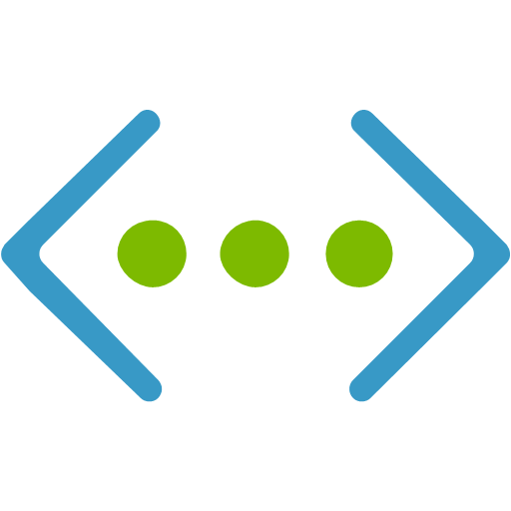
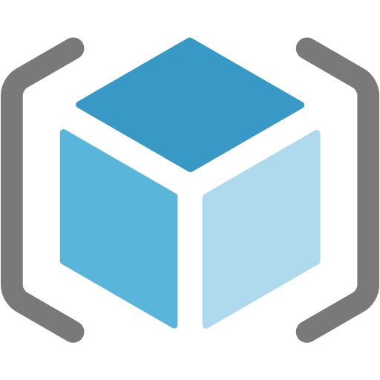
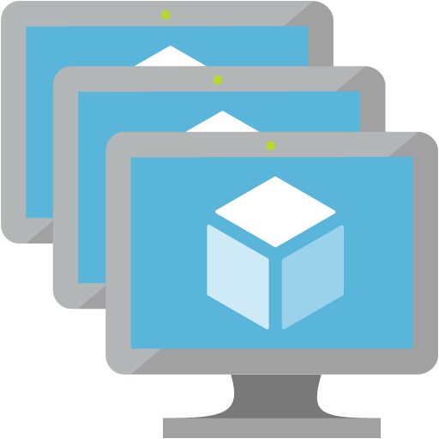

Topics Explored
Compute
Storage
Networking
Hybrid-Cloud
Azure Resource Manager
Identity & Security

Slide 3
Agenda
Technical Briefing: Azure IaaS
Microsoft Cloud Workshop: Building a Resilient IaaS Architecture
Whiteboard Design Session
Team Challenge

Slide 4

Azure Subscriptions
A subscription is a logical unit of Azure services used for access management and billing administration
Companies can have an unlimited number of subscriptions
Subscriptions help you organize access to cloud service resources
Notes:
✔️ Do you know how many subscriptions your organization has? Do you know how resources are organized into resource groups?

Slide 5
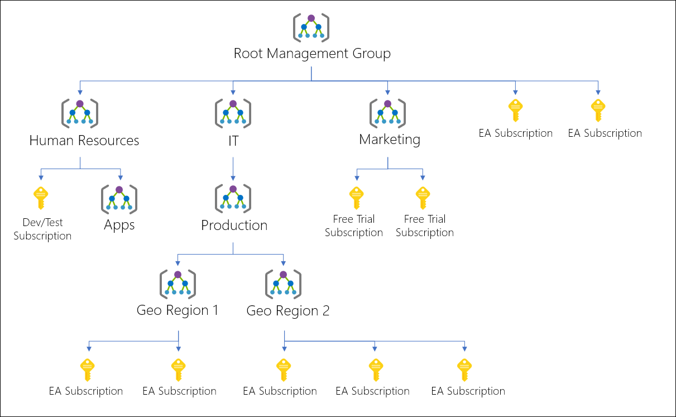
Management Groups
Provides a level of scope above subscriptions
Organizational alignment through custom hierarchies and grouping
Targeting of policies and spend budgets across subscriptions and inheritance down the hierarchies
Compliance and cost reporting by organization (business/teams)
Notes:
Management groups are containers that help you manage access, policy, and compliance across multiple subscriptions. Create these containers to build an effective and efficient hierarchy that can be used with Azure Policy and Azure Role Based Access Controls.

Slide 6
Azure AD and Azure Subscriptions
Each Azure Subscription is linked to one Azure AD directory
Users and groups in the Azure AD directory can be assigned access to resources in an Azure subscription
Azure AD Roles are outside of the Azure Subscription
Just because you have access to Azure AD does not mean you have access to the Azure subscription
contoso.com
Directory
DEV
TST
PRD
Notes:
When considering the relationship between Azure AD and Azure subscriptions, it’s important to understand that a subscription can be linked to 1 and only 1 AAD tenant. However and AAD tenant can have multiple subscriptions linked to it. Another important thing to understand is that AAD tenants have their own roles that are specific to the tenant only. Having access to an AAD tenant does not imply access to the subscription.

Slide 7

Azure Policy
Service in Azure that you use to create, assign and, manage policies
Runs evaluations and scans for non-compliant resources
Advantages:
Enforcement and compliance
Apply policies at scale
Remediation

Slide 8
Azure Policy
Define what actions are allowed
Policies are described via Policy Definitions
Policies are applied via Policy Assignments
Scoped at:
Management Group
Subscription
Resource Group
Resource

Slide 9
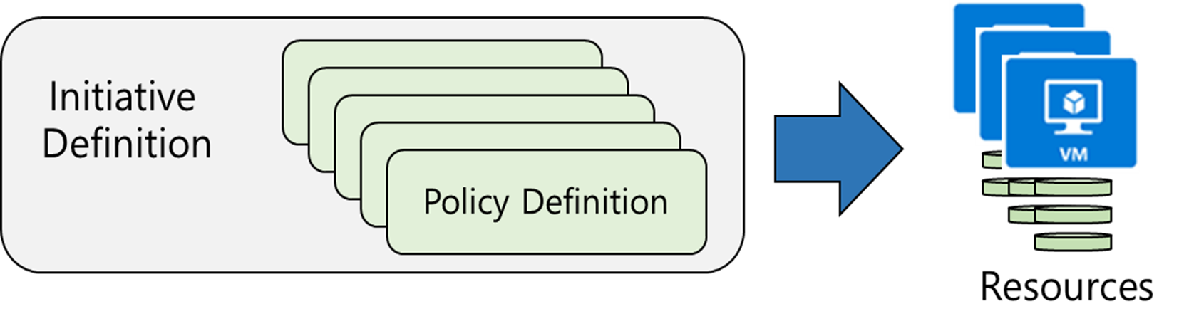
Implementing Azure Policy
Define Policies
Assign Policies
Notes:
The next four topics step you through creating an Azure policy.
✔ Even if you have only a few Policy Definitions, we recommend creating an Initiative Definition.

Slide 10
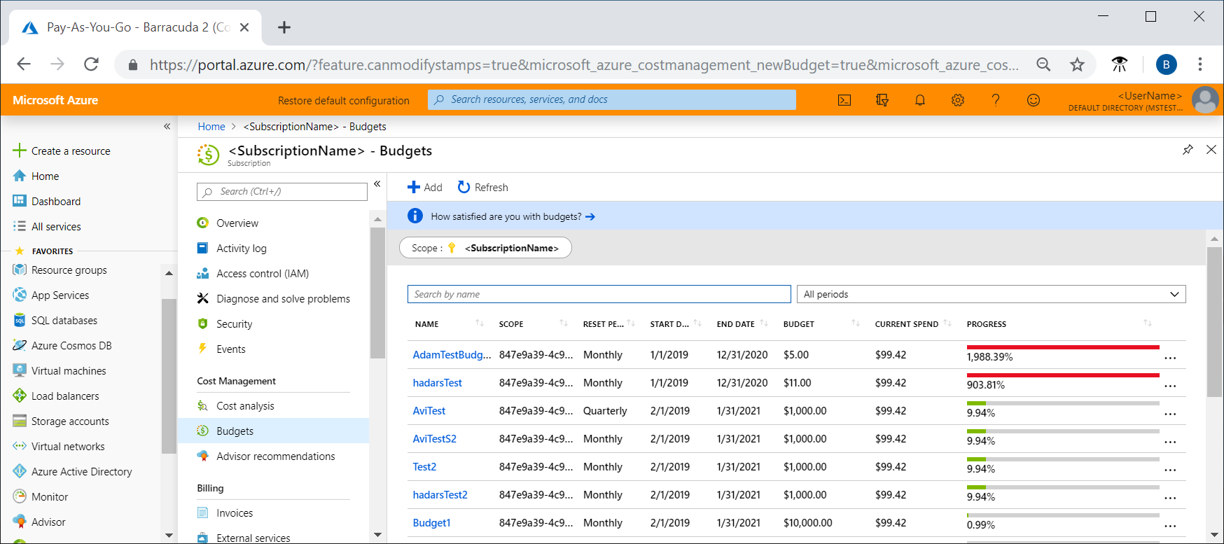
Create and manage budgets
Azure subscription budget for a monthly, quarterly, or annual period
Navigate to Subscriptions, select a subscription from the list, and then select Budgets in the menu
Use the Scope pill to switch to a different scope, like a management group, in Budgets.

Slide 11
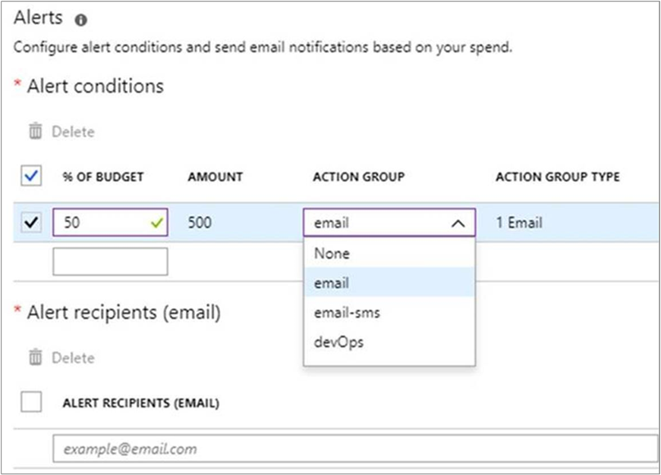
Create alerts for Azure budgets

Slide 12
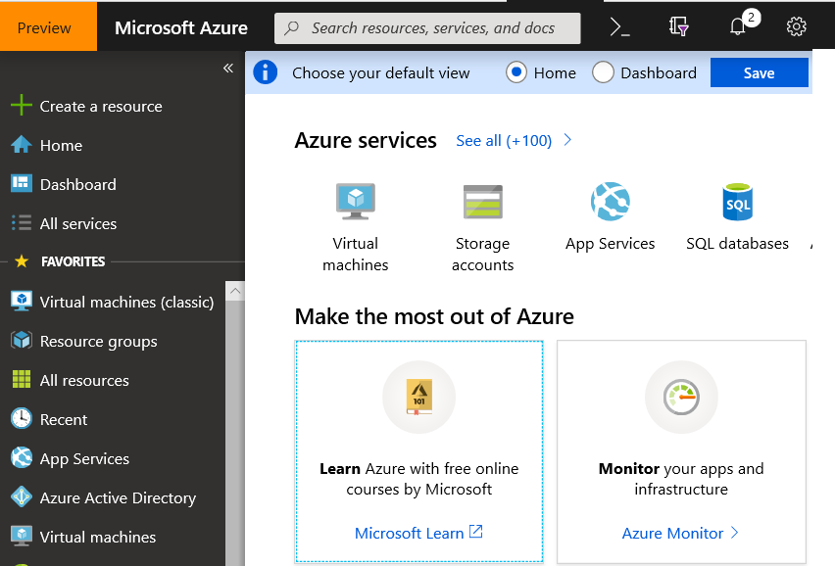
Azure Portal
Search resources, services, and docs
Manage resources
Create customized dashboards and favorites
Access the Cloud Shell
Receive notifications

Slide 13
Azure Mobile App
Stay connected to the cloud
Check status and critical metrics anytime, anywhere
Diagnose and fix issues quickly
Run commands to manage your Azure resources

Slide 14
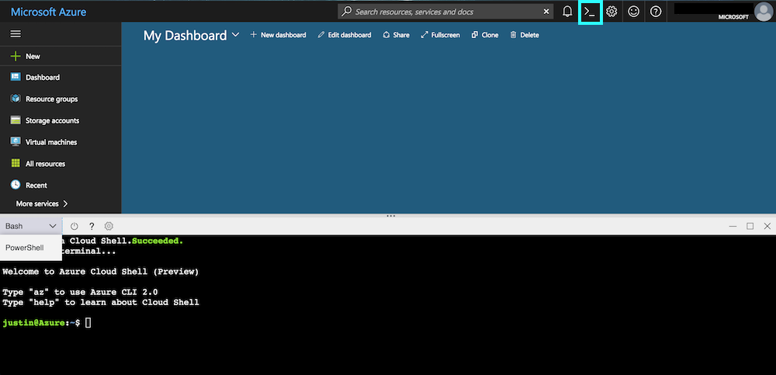
Azure Cloud Shell
Connect to CLI from the Azure Portal
Auto-Authentication
Integrated editor
http://shell.azure.com

Slide 15
Demo Azure Portal, Cloud Shell, Subscriptions, Resource Groups, Locks
Notes:
1. Open the Azure portal and browse around (make sure you have resources deployed in your target subscription)
2. Open the Cloud Shell and show using Bash command
az vm list -o table
3. Switch to PowerShell in Cloud Shell
Get-AzVm

Slide 16
Compute

Slide 17

Virtual Machines & Scale Sets
Minimal learning curve for existing virtualization pros
Run most Windows or Linux-based workloads
Easiest target for migrating to the cloud
Flexible instance sizes – use the best fit for your workload
Advanced networking and storage capabilities
Virtual Machines
All of the power and flexibility of a Virtual Machine
Designed for high-end workloads
Automatically scale up (or down) to 1000 instances
Virtual Machine Scale Sets

Slide 18


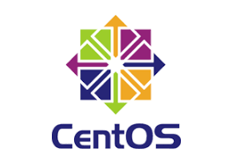

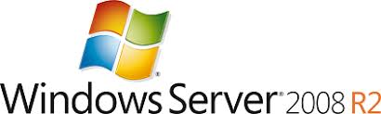

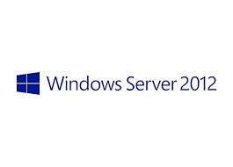
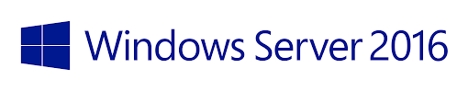



Supported Configurations
Windows Server
Windows Server 2019

Slide 19


Compute Options for all types of apps
A
Av2
B
D
Dv2
Dv3
DC
F
Fv2
ENTRY LEVEL
BURSTABLE
GENERAL PURPOSE
COMPUTE OPTIMIZED
G
Ev3
M
L
NC
NV
NCv2
ND
H
MEMORY OPTIMIZED
STORAGE OPTIMIZED
GRAPHICS INTENSIVE
HIGH PERFORMANCE COMPUTING
HANA
PURPOSE-BUILT FOR
SAP HANA

Slide 20
Availability Options
VM SLA
VM SLA
VM SLA
MULTI-REGION DISASTER RECOVERY
99.9% (Premium Storage)
99.95%
99.99%
Region 1
Region 2
SINGLE VM
AVAILABILITY SETS
AVAILABILITY ZONES
REGION PAIRS
Easier lift and shift
Protecting against failures within datacenters
Protection from entire datacenter failures
Regional protection within Data Residency Boundaries

Slide 21
Availability Sets
Informs Azure which VMs perform like services
Provides fault domains & upgrade domains
Required for 99.95% SLA
Fault Domain
0
Fault Domain
1
Server Rack
Server Rack
Availability Set WEB
Availability Set DB

Slide 22
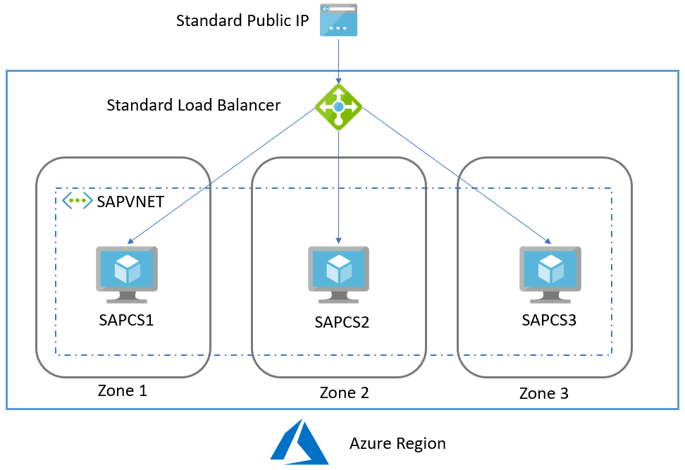
Availability Zones
Must use Standard Load Balancer & PIP with AZs
Deploy VMs or Scale Sets in specific zones
Zone redundant load balancer
Required for 99.99% SLA

Slide 23
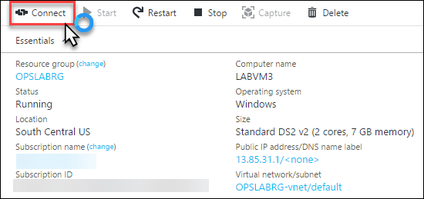
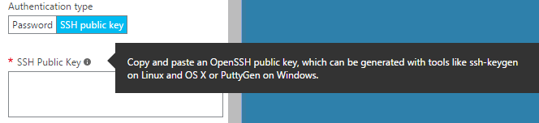
Remotely Managing an Azure VM
Connect to a Windows VM via RDP
RDP File is downloaded from Portal
User Name & Password set when creating VM
SSH available for Linux

Slide 24

Resizing Virtual Machine (Scale Up / Scale Down)
Not automated by design as part of the auto-scale rules, but can be scripted with PowerShell
Requires a Reboot
Cannot scale down if you have more data disks attached than the lower size supports or if the instance size is not supported in the cluster your cloud service is created in
Scale Up
Scale Down

Slide 25
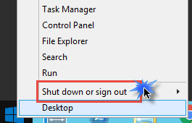
Stopping an Azure Virtual Machine
Virtual Machines Support two Stopped States
Stopped (deallocated)
No longer paying for CPU (still paying for storage)
Will lose IP address if not marked static (public or private)
Stop via portal or command line tools
Stopped
OS is shutdown, but still paying for compute
Stop from within OS or command line tools (optional)
Portal Denotes VM Status

Slide 26
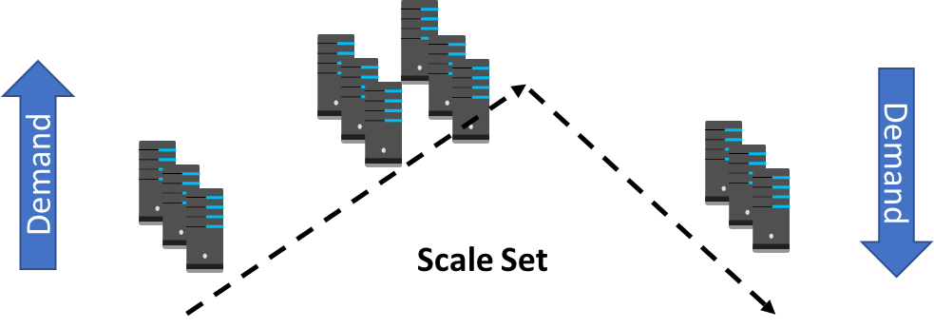
Scale Sets
Scale sets deploy a set of identical VMs
No pre-provisioning of VMs is required
As demand goes up VMs are added
As demand goes down VM are removed
The process can be manual, automated, or a combination of both

Slide 27
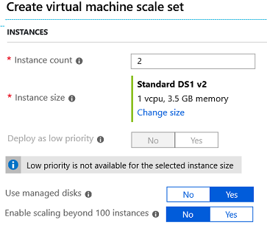
Implementing Scale Sets
Instance count. Number of VMs in the scale set (0 to 1000)
Instance size. The size of each virtual machine in the scale set
Deploy as low priority. Can save up to 80%
Use managed disks
Enable scaling beyond 100 instances

Slide 28
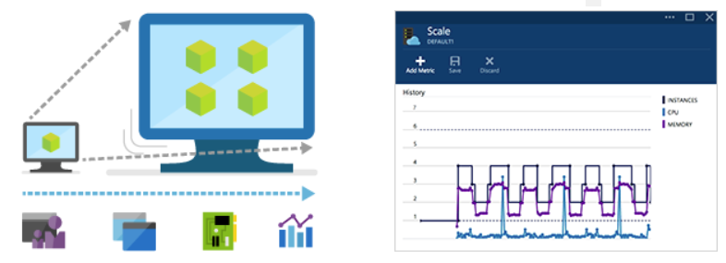
Autoscale
Define rules to automatically adjust capacity
Scale out (increase) the number of VMs in the set
Scale in (reduce) the number of VMs in the set
Schedule events to increase or decrease at a fixed time
Reduces monitoring and optimizes performance
Notes:
✔️ Autoscale minimizes the number of unnecessary VM instances that run your application when demand is low, while customers continue to receive an acceptable level of performance as demand grows and additional VM instances are automatically added.

Slide 29
Azure Reserved Instances
Reserve virtual machines in advance
Select 1- or 3-year terms with significant benefits
Significant cost savings up to 82%* over pay-as-you-go models
Budget predictability and prioritized compute capacity
Flexibility to modify reservations and simplicity of purchase
*When combined with Azure Hybrid Benefit

Slide 30
Azure Hybrid Benefit for Windows Server
Pay for just base compute costs by using your existing Windows Server licenses with Software Assurance
Apply licenses to Azure for use with Azure Reserved VM Instances
Maximize value from current investments
Available for both pay-as-you-go and Azure Reserved VM Instances

Slide 31
Discussion Point
What advantages do you see for customers that have large numbers of Windows VMs?
Can you tell the Linux on Azure Story?
How do you think Hybrid Use Benefits and Reserved Instances help to sell Azure?

Slide 32
Storage

Slide 33

Azure Storage
Blobs
Highly scalable, REST based cloud object store
Block Blobs: Sequential file I/O
Cool Tier Available
Page Blobs: Random-write pattern data
Append Blobs
Disks
Persistent disks for Azure IaaS VMs
Premium Storage Disks option: SSD based, high IOPS, low latency
Files
Fully Managed File Shares in the Cloud
SMB and REST access
“Lift and shift” legacy apps
Synch with on-premises (New!)
Tables
Massive auto-scaling NoSQL store
Dynamic scaling based on load
Scale to PBs of table data
Fast key/value lookups
Queues
Reliable queues at scale for cloud services
Decouple and scale components
Message visibility timeout and update message to protect against unreliable dequeuers
Built on a unified Distributed Storage System
Durability, Encryption at Rest, Strongly Consistent Replication, Fault Tolerance, Auto Load-Balancing

Slide 34
Accessing Storage
Every object has a unique URL address
The storage account name forms the subdomain of that address
The subdomain and domain name forms an endpoint
Blob service: https://mystorageaccount.blob.core.windows.net
Table service: https://mystorageaccount.table.core.windows.net
Queue service: https://mystorageaccount.queue.core.windows.net
File service: https://mystorageaccount.file.core.windows.net
If you prefer you can configure a custom domain name
CNAME record | Target
blobs.contoso.com | contosoblobs.blob.core.windows.net
Notes:
Endpoints are covered in more detail in the Virtual Networking lesson.
✔️A Blob storage account only exposes the Blob service endpoint. And, you can also configure a custom domain name to use with your storage account.

Slide 35
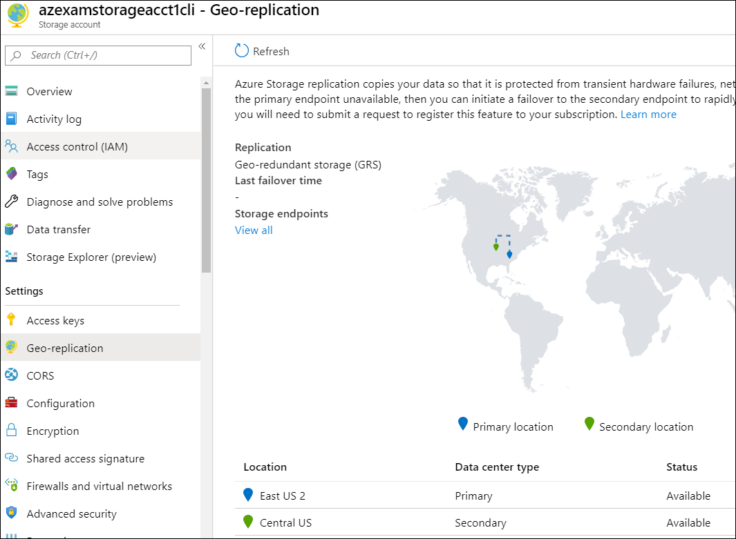
Enable Geo-replication
Must use the correct SKU for GRS
Enable replication to Region Pair
az storage account create \
-n azexamstorageacct1cli \
-g AZ-103-Storage-RG \
-l eastus2 \
--sku Standard_GRS

Slide 36


Access Keys
Use access keys to authenticate applications to Azure storage accounts
Store keys securely in Azure Key Vault
Azure provides two access keys, so that you can maintain connections using one key while regenerating the other

Slide 37
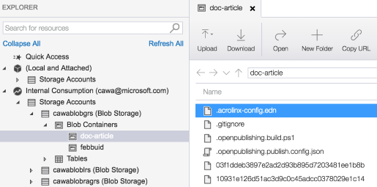
Azure Storage Explorer
Access multiple accounts and subscriptions
Create, delete, view, edit storage resources
View and edit Blob, Queue, Table, File, Cosmos DB storage and Data Lake Storage
Obtain shared access signature (SAS) keys
Available for Windows, Mac, and Linux

Slide 38

Import and Export Service
Import/transfer large amounts of data to Azure Blob storage and Azure Files
Export/transfer data from Azure storage to hard disk drives
Migrating data to the cloud
Content distribution
Backup
Data recovery
Notes:
✔️ A single job can include up to 10 disks. You can create jobs directly from the Azure portal. You can also accomplish this programmatically by using Azure Storage Import/Export REST API.

Slide 39

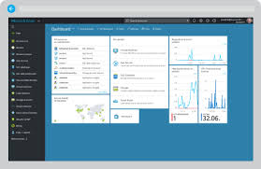




Azure Import / Export Service
Create Job in Azure Portal
1
Securely transfer large amounts of data to Azure blob storage by shipping hard disk drives to an Azure data center
Data must be Encrypted
2
Copy Data to Drives & Encrypt
3
Ship Drives to Microsoft
4
Microsoft Copies data to Azure Storage

Slide 40
Azure Storage
Blobs
Highly scalable, REST based cloud object store
Block Blobs: Sequential file I/O
Cool Tier Available
Page Blobs: Random-write pattern data
Append Blobs
Disks
Persistent disks for Azure IaaS VMs
Premium Storage Disks option: SSD based, high IOPS, low latency
Files
Fully Managed File Shares in the Cloud
SMB and REST access
“Lift and shift” legacy apps
Synch with on-premises (New!)
Tables
Massive auto-scaling NoSQL store
Dynamic scaling based on load
Scale to PBs of table data
Fast key/value lookups
Queues
Reliable queues at scale for cloud services
Decouple and scale components
Message visibility timeout and update message to protect against unreliable dequeuers
Page Blobs or Disks can be used with Azure VMs to provide Disk Storage for OS & Data Volumes
Built on a unified Distributed Storage System
Durability, Encryption at Rest, Strongly Consistent Replication, Fault Tolerance, Auto Load-Balancing

Slide 41

Virtual Machine Storage Basics
Premium disks
SSD based, high IOPS, low latency
Up to 64 TB, 80000 IOPs
Appropriate for data base, file servers, and interactive applications that have a dependency on high IOPs and low latency storage
Standard disks
Magnetic disks, HDD based. Up to 500 IOPs/disk
Recommended only for Dev Test or servers that do not have a dependency on high IOPs or low latency storage

Slide 42



Azure Disks
Performance Tiers
Management Options
Resource Group
Resource Group
Standard Storage Account
Premium Storage Account
Premium Disks (SSD)
Standard Disks (HDD)
Managed Disks
Unmanaged Disks
/Page Blob
Premium Disks: SSD based, provisioned performance
Standard Disks: HDD based, cost effective
Managed Disks: highly available & manageable
Unmanaged Disks: legacy with Storage Account

Slide 43
Azure Disk Portfolio
Standard HDD
Standard SSD
Premium SSD
Ultra Disk
Single disk max value
Low-cost storage
Consistent performance
High performance
Sub-millisecond latency
Size
32 TiB
32 TiB
32 TiB
64 TiB
IOPS
2,000
6,000
20,000
160,000
Bandwidth
500 MBps
750 MBps
900 MBps
2,000 MBps
Workloads
Backups, low end file server
Big Data, entry-level Web Servers
Databases, enterprise production, container volumes
SAP HANA, SAN, Tier-1 workloads
http://aka.ms/azuredisks

Slide 44
Managed Disks: Improve Availability
Unmanaged ARM Availability Set
Managed ARM Availability Set
VS
FD0
FD1
FD2
FD0
FD1
FD2
Storage account 0
Storage account 1
Storage account 2
Storage Stamp 0
Storage Stamp 0
Storage Stamp 1
Storage Stamp 2
VMs susceptible to single storage stamp failures
Disks on separate storage stamps & aligned with VM fault domains

Slide 45
Networking

Slide 46

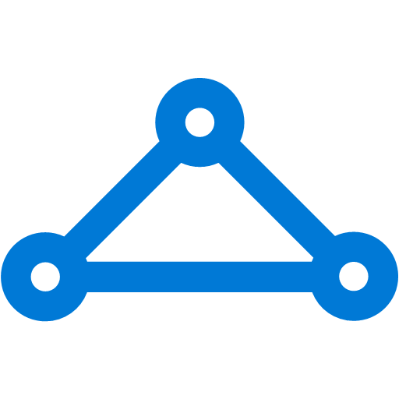


Virtual Network
Bring your own network
Segment with subnets and security groups
Control traffic flow with user defined routes
Azure Virtual Network
Users
Internet
Front-End Access
Dynamic/Reserved public IP addresses
Direct VM access, ACLs for security
Load balancing
DNS services: hosting, traffic management
Traffic Manager
DDoS protection
Backend connectivity
Point-to-site for dev/test
VPN Gateways for secure site-to-site connectivity
ExpressRoute for private enterprise grade connectivity
MPLS
Backend connectivity
ExpressRoute
and
VPN
VPN

Slide 47
Azure Networking
Virtual network
Private IP addresses, Network-level isolation
Segment with subnets and security groups
Control traffic flow with user-defined routes
Internet access
Azure virtual network
ExpressRoute
VPN gateways
Hybrid connectivity
Point-to-site for dev/test
VPN gateways for secure site-to-site connectivity
ExpressRoute for private enterprise grade connectivity
Domain-join with on-premises

Slide 48




Networking types
Local Area Network
Wide Area Network
Virtual Network

Slide 49
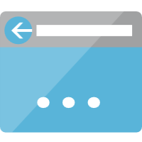
IP Addressing
IP addresses consist of four numbers, each between 0 and 255
75.74.137.173
10.0.1.11
172.16.10.41
192.168.0.102
127.0.0.1
Uniquely identifies a computer from all over computers
To function: IP address, Subnet mask, Default Gateway

Slide 50
IPv4 Addressing
Each networked computer must be assigned a unique IPv4 address
Network communication for a computer is directed to the IPv4 address of the computer
Each IPv4 address contains:
Network ID, identifying the network
Host ID, identifying the computer
The subnet mask identifies which part of the IPv4 address is the network ID (255) and the host ID (0)
IP address | 172 | 16 | 0 | 10
Subnet mask | 255 | 255 | 0 | 0
Network ID | 172 | 16 | 0 | 0
Host ID | 0 | 0 | 0 | 10

Slide 51
Public vs Private IP Addresses
Required by devices and hosts that connect directly to the Internet and globally unique
Routable on the Internet
Must be assigned by IANA/RIR
Public
Not routable on the Internet
10.0.0.0/8, 172.16.0.0/12, 192.168.0.0/16
Assigned locally by private organization
Must be translated to access the Internet
Private
Notes:
https://docs.microsoft.com/en-us/azure/virtual-network/virtual-network-ip-addresses-overview-arm

Slide 52
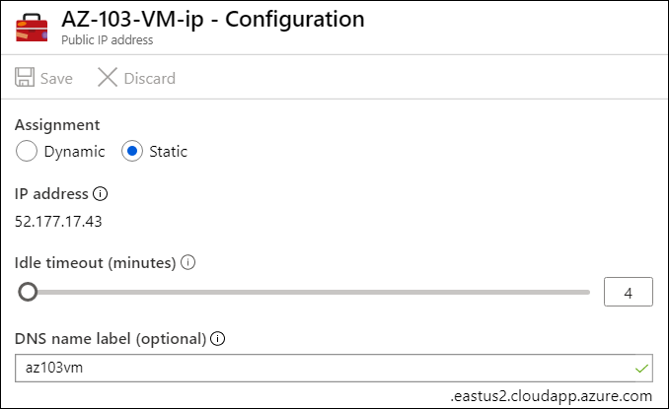
Public IP Address Assignment
A public IP can be assigned directly to a Network interface, Azure Load balancer, Application Gateway, Azure Firewall
Supports static or dynamic assignment
Optionally supports specifying a DNS label
Configurable idle timeout

Slide 53
Virtual Machine Networking
IPv4 and IPv6 Support
Support for multiple network interfaces for routing and firewalls
Private and/or Public IP addresses (static or dynamic)
Network Security Groups for traffic isolation
Automatic assignment of DNS servers from virtual network or from Azure DNS
Accelerated Networking
MAC Persistence

Slide 54
Static vs Dynamic Addresses
Static IP address
Manually assigned to a host
Dynamic IP addresses
More common than static IP addresses, whereas hosts automatically obtain an IP address (and other IP information)

Slide 55
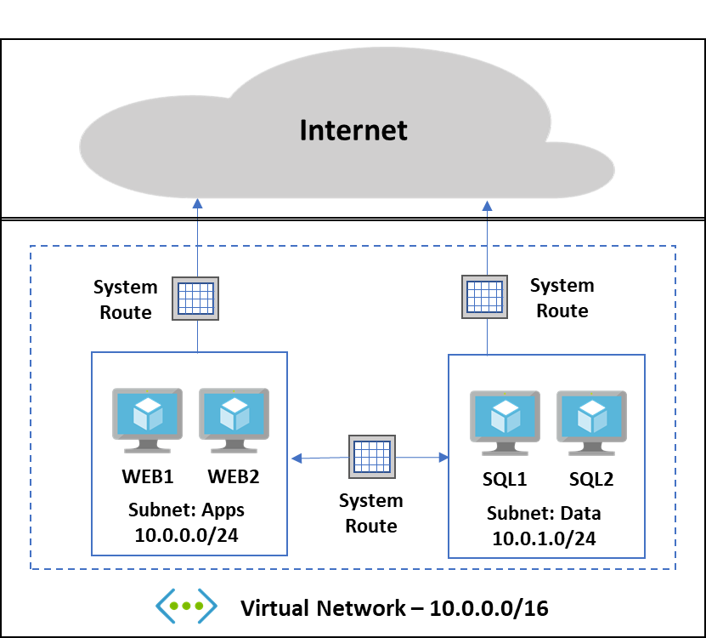
Virtual Networks
Isolated Network which allows Cloud Resources to communicate
Access to Internet by default
Virtual Networks can be connected to each other in the same region or other regions
On-Premises connectivity is possible enabling hybrid cloud
Traffic can be filtered by Source & Destination IP Address, port & protocol

Slide 56
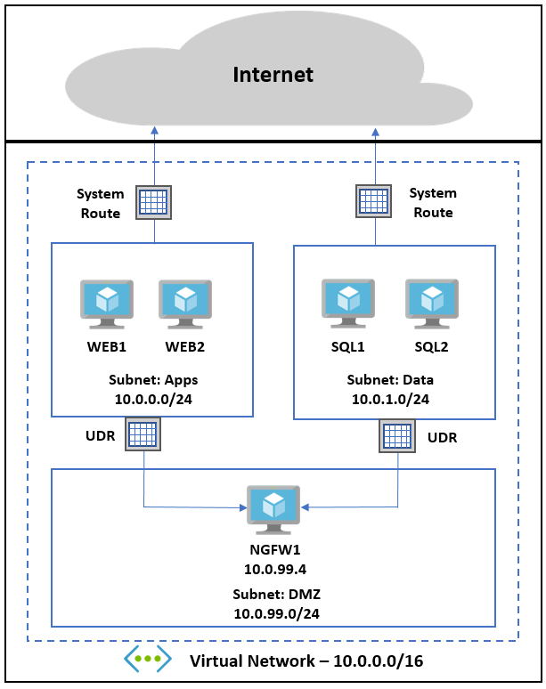
User defined routes
Administrators can change default routing behavior
Routing can be configured to direct traffic through devices such as Virtual Firewalls to create a DMZ

Slide 57


Name Resolution
Name resolution is a method of reconciling an IP address to a user friendly computer name
Originally networks used HOSTS files to resolve names to IP addresses
hosts
server1 192.168.0.5
server2 192.168.0.8
server3 192.168.0.11
server1
server2
server3
workstation1

Slide 58

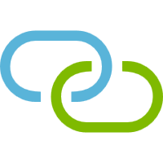


DNS Services
Resolve host names to IP addresses
Locate domain controllers and global catalog servers
Resolve IP addresses to host names (reverse lookup)
Locate mail servers during email delivery

Slide 59
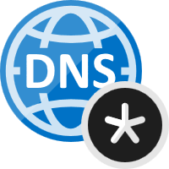
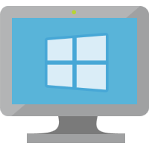
Azure VNET DNS
Name resolution is provided between VMs in virtual networks
No configuration is required
Highly available
Hello Azure DNS:
What’s the IP address of server2?
Hello10.0.1.4:
Server2 is at 10.0.1.5
ping 10.0.1.5
ping server2
Server1
10.0.1.4
reply
Server2
10.0.1.5

Slide 60
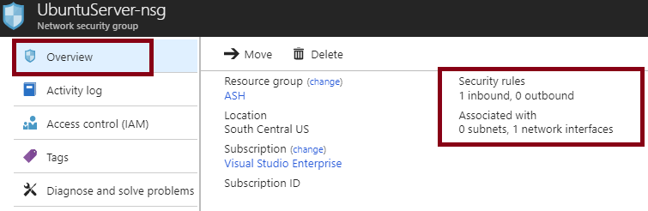
Network Security Groups (NSG)
You can limit network traffic to resources in a virtual network using a NSG
A NSG contains a list of security rules that allow or deny inbound or outbound network traffic
An NSG can be associated to a subnet or a network interface
Notes:
✔️ To simplify management of security rules, it's recommended that you associate a network security group to individual subnets, rather than individual network interfaces within the subnet.
For more information, you can see:
Network Security Groups - https://docs.microsoft.com/en-us/azure/virtual-network/security-overview#network-security-groups

Slide 61


Stateful Firewall Rules using NSGs
N-Tier Example
Virtual Network
Address Space: 172.16.0.0/16
Subnet Web: 172.16.1.0/24
Allowed via NgnixSecurityGroup
NginixSecurityGroup
SRC ADDRESS PREFIX: INTERNET
SRC PORT RANGE: *
DEST PORT RANGE: 80
DEST ADDRESS PREFIX: 172.16.1.0/24
PROTOCOL: TCP
NGINX-VM1
Subnet Web
172.16.1.4
NGINIX-VM2
Subnet Web
172.16.1.5
NGINIX-VM3
Subnet Web
172.16.1.6
NGINIX-VM4
Subnet Web
172.16.1.7
Allowed via PostgreSQLSecurityGroup
PostGreSQLSecurityGroup
SRC ADDRESS PREFIX: 172.16.1.0/24
SRC PORT RANGE: *
DEST PORT RANGE: 5432
DEST ADDRESS PREFIX: 172.16.2.0/24
PROTOCOL: TCP
Subnet SQL: 172.16.2.0/24
Remember that OS Ports & Firewalls must be configured to allow traffic
PGRESQL-VM1
Subnet SQL
172.16.2.4
PGRESQL-VM2
Subnet SQL
172.16.2.5

Slide 62
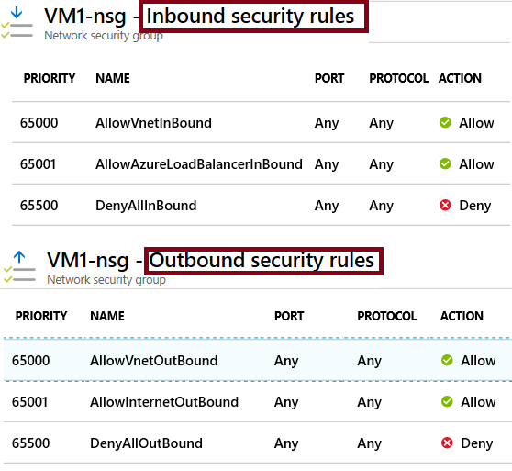
NSG Rules
Security rules in NSGs enable you to filter network traffic that can flow in and out of virtual network subnets and network interfaces.
There are default security rules.
You cannot delete the default rules, but you can add other rules with a higher priority.

Slide 63
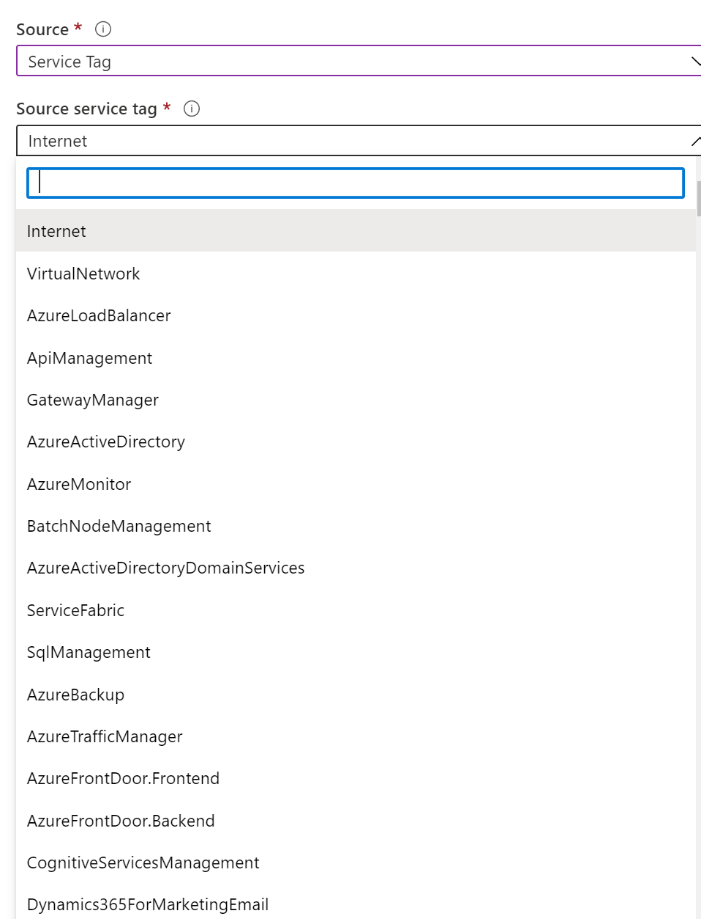
Service Tags
A service tag represents a group of IP address prefixes from a given Azure service.
Microsoft manages the address prefixes encompassed by the service tag
Automatically updates the service tag as addresses change, minimizing the complexity of frequent updates to network security rules.

Slide 64

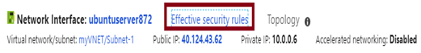
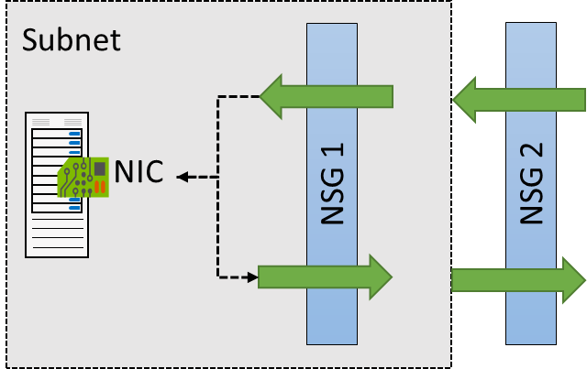
NSG Effective Rules
NSGs are evaluated independently for the subnet and NIC
An “allow” rule must exist at both levels for traffic to be admitted
Use the Effective Rules link if you are not sure which security rules are being applied

Slide 65
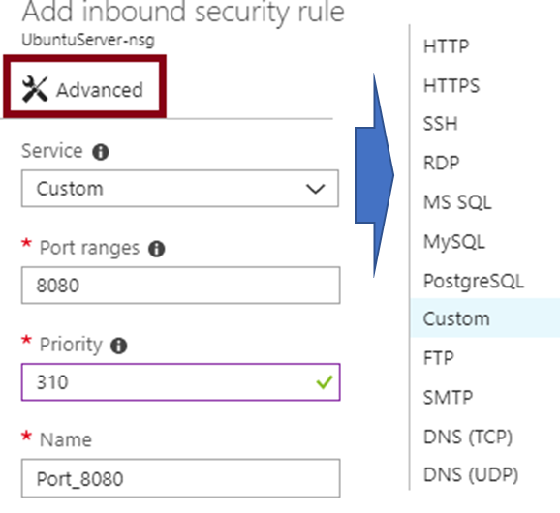
Creating NSG Rules
Select from a large variety of services
Service - The destination protocol and port range for this rule
Port ranges – Single port or multiple ports
Priority - The lower the number, the higher the priority

Slide 66
Demo NSGs

Slide 67
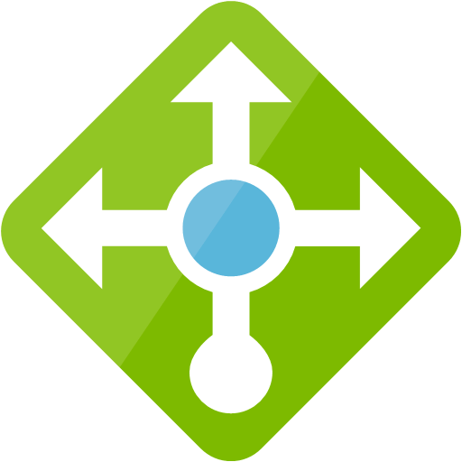




Load Balancing
Load Balancer
Application Gateway with WAF
Traffic Manager
Front Door
3rd Party Solutions from Marketplace

Slide 68
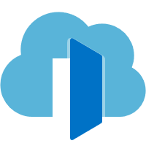
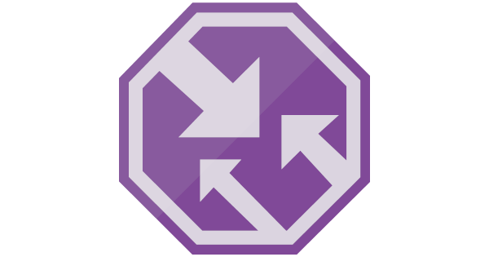
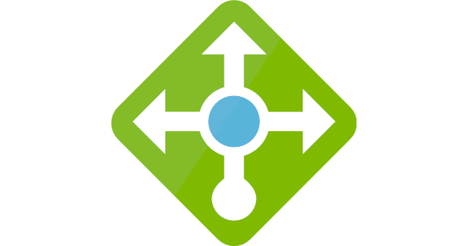
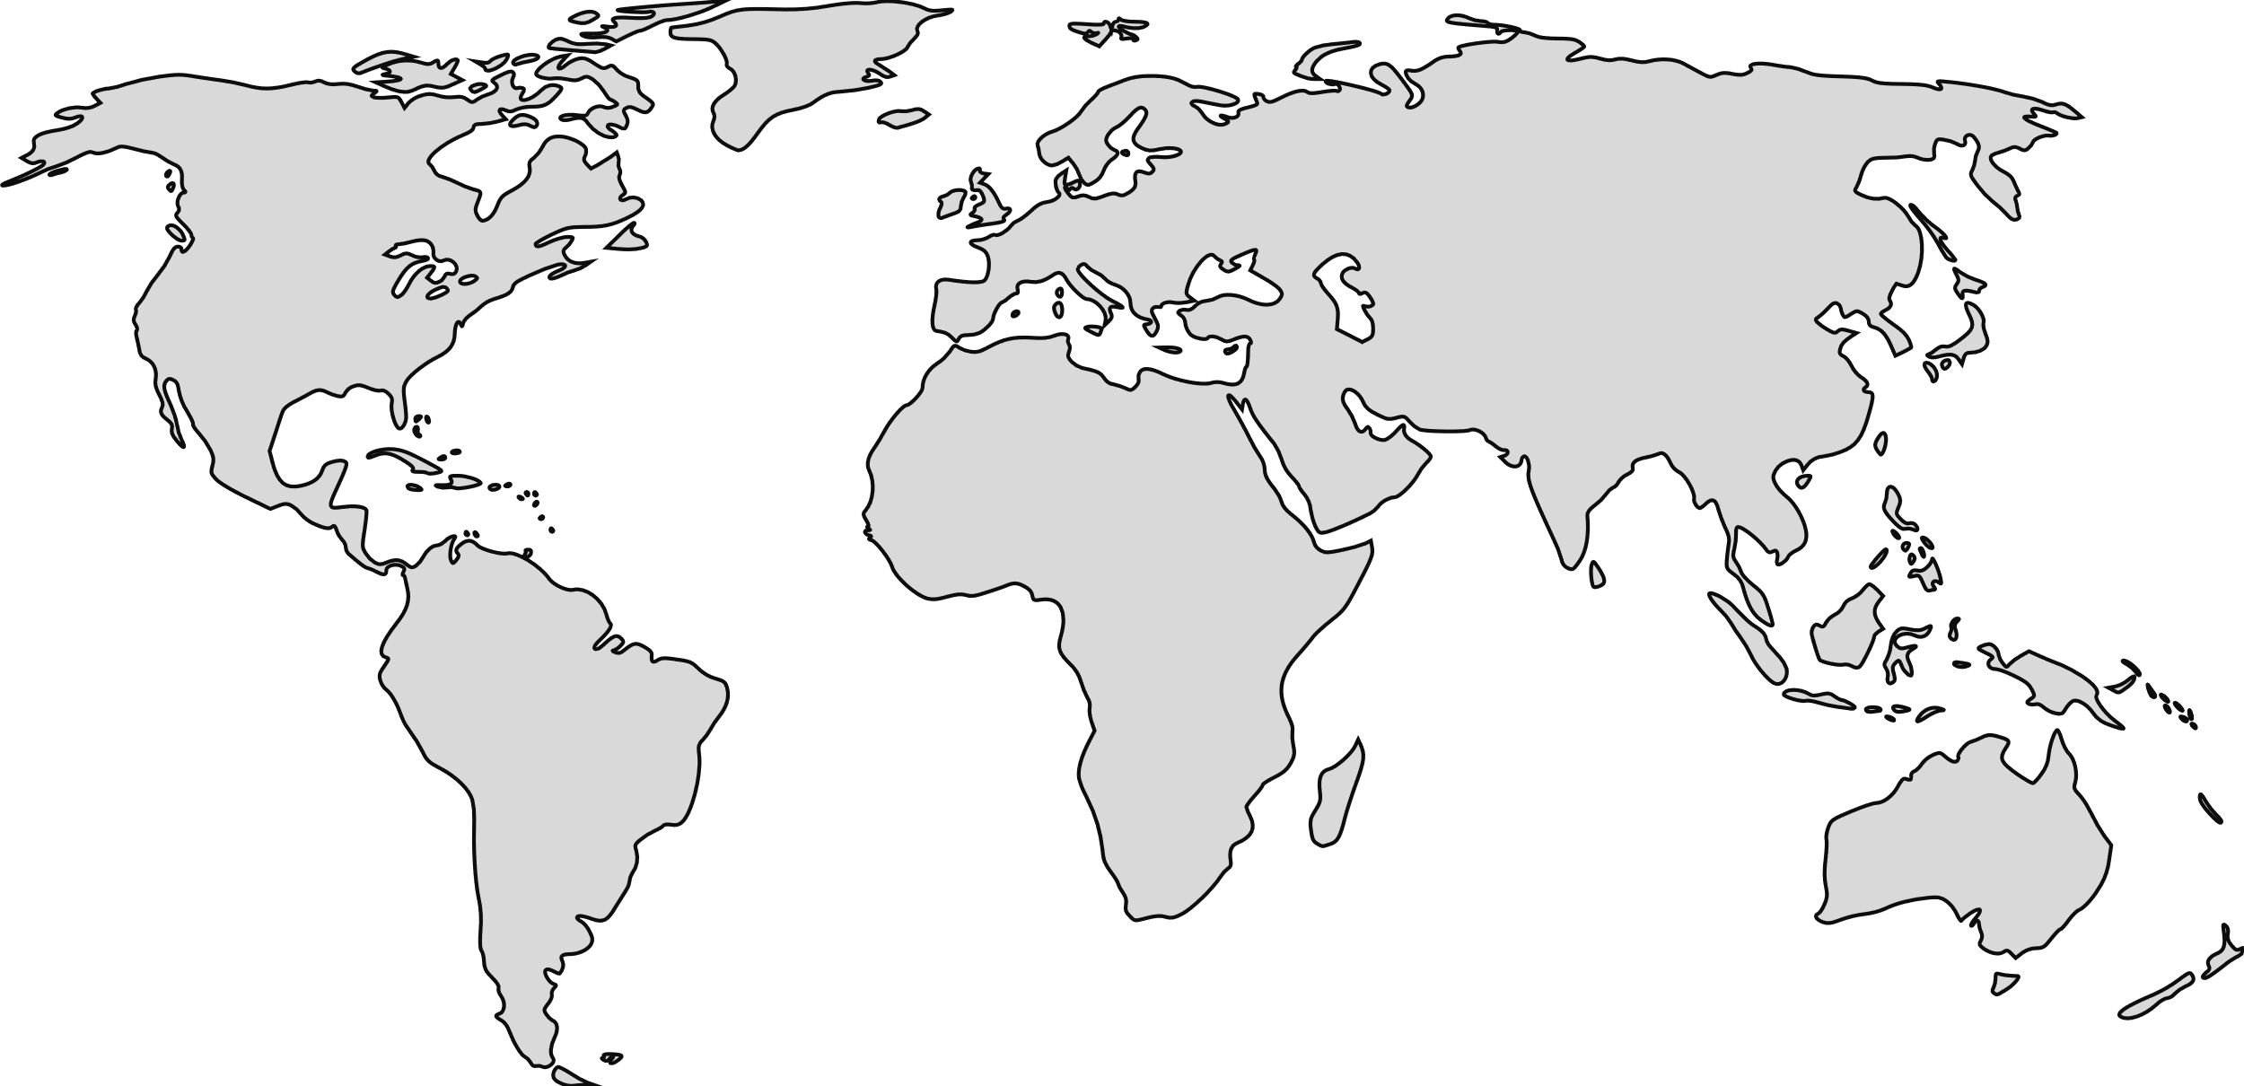




Load balancing in Azure
Front Door
Application Gateway
Application Gateway
Traffic Manager
Load Balancer
(Public)
Load Balancer (Internal)
Global
Region / Zone
Global
Regional
Internal
Route to your closest available service region or your on-prem DC. Offload SSL, improve performance / accelerate websites at the Edge.
Route across zones and into your VNET. Offload SSL and build your application-specific logic.
Route across and between your resources to build your regional application.

Slide 69
Traffic Manager
DNS Based Traffic Distribution
Four Distribution Algorithms
Performance, Weighted, Priority (Fail Over), Geographic
Map your domain name to yourservice.trafficmanager.net with CNAME
www.contoso.com -> contosotm.trafficmanager.net
Map URLs from Azure or custom URLs (outside of Azure) using a Traffic Manager profile.
contosoeast.eastus.azure.com
contosowest.westus.azure.com
host1.contoso.com
Built in HTTP Health Probes for High Availability

Slide 70
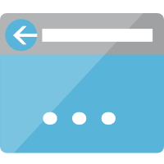
Traffic Manager: Priority
Traffic Manager always returns the IP address of the primary endpoint unless it fails a health check
ALL Requests
contososaptm.trafficmanager.net
ALL Requests
Request for sap.contoso.com
Request for sap.contoso.com
Response with IP for Primary POP
Response with IP for Secondary POP
contososapcs.westus.cloudapp.azure.com
Health Probes
contososapcs.eastus.cloudapp.azure.com
Primary
POP
Secondary
POP
CS-WUS-02
CS-WUS-02
CS-EUS-01
CS-EUS-01
Zone 1
Zone 2
Zone 1
Zone 2
West US
East US
Notes:
The Failover load balancing algorithm returns the IP address for the primary site, unless there is an availability issue. If that happens, it will return the endpoint from one of the other endpoints in the failover order that you specify.
For example:
<Click>
A client requests contoso.com, and …
<Click>
… Traffic Manager responds with the IP address for contosowest.cloudapp.net.
<Click>
The client makes the request with the resolved IP.
<Click>
The primary endpoint in West US goes down, and Traffic Manager marks the endpoint as being “degraded.”
<Click>
When the next client request comes in …
<Click>
Traffic Manager responds with the IP address for contosoeast.cloudapp.net …
<Click>
… and the client makes the service request with the resolved IP address.

Slide 71
Traffic Manager: Performance
Traffic Manager determines fastest route for the client and returns IP for the appropriate endpoint
Location Seattle, WA
contososaptm.trafficmanager.net
Request for sap.contoso.com
Traffic Manager Calculates Hops…
Response with IP for West US POP
contososapcs.westus.cloudapp azure.com
Health Probes
contososapcs.eastus.cloudapp.azure.com
CS-WUS-02
CS-WUS-02
CS-EUS-01
CS-EUS-01
Zone 1
Zone 2
Zone 1
Zone 2
West US
East US

Slide 72


Azure Load Balancer
Inbound
Outbound
Cloud native network load balancer
Built-in high-availability and performance
Inbound and Outbound
Public and Internal load balancing
Availability Zones
Flexible for all TCP or UDP applications
Any VM in a VNet
HA Ports for n-active resiliency
Health probe for TCP, HTTP, and HTTPS
Metrics in Azure Monitor
Multi-dimensional
3rd party integration
Health
Probe
AZ1
AZ2
VMSS
VMSS
VNet
Pool
SNAT ports
per VM
VNet
HA Ports for Appliances
VNet

Slide 73
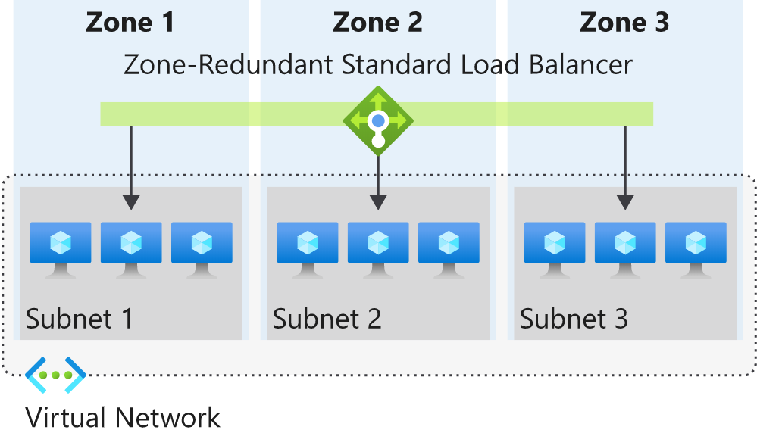
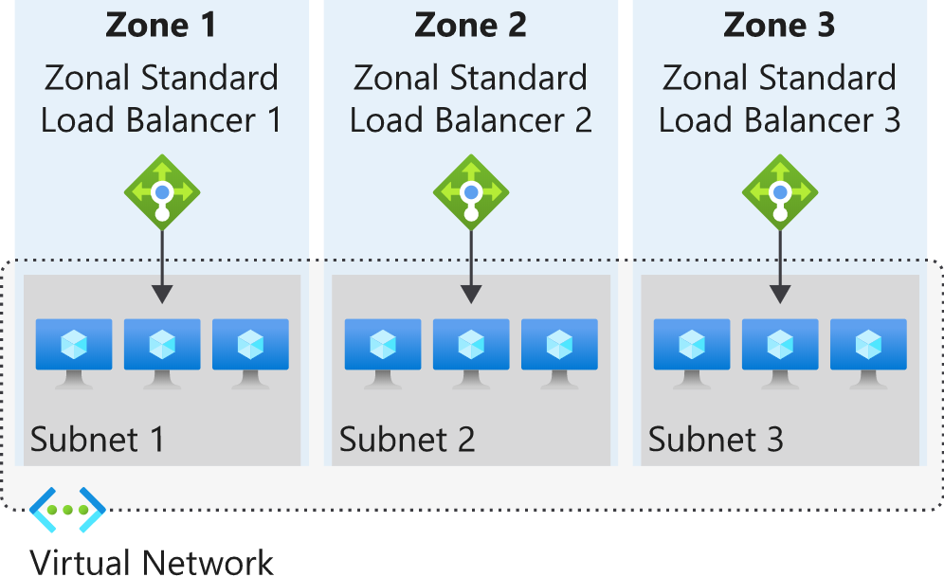
Using Standard Load Balancer with Availability Zones
Zone redundant
Standard load balancer frontend can be zone-redundant
Multiple zones can serve inbound or outbound in a region and traffic is served by a single IP address
One or more availability zones can fail, and the data path survives if one zone in the region remains healthy
Zonal
You can choose to have a frontend guaranteed to a single zone, which is known as a zonal frontend.
This scenario means any inbound or outbound flow is served by a single zone in a region.
Frontend shares fate with the health of the zone. The data path is unaffected by failures in zones other than where it was guaranteed.
Notes:
https://docs.microsoft.com/en-us/azure/load-balancer/load-balancer-standard-availability-zones

Slide 74
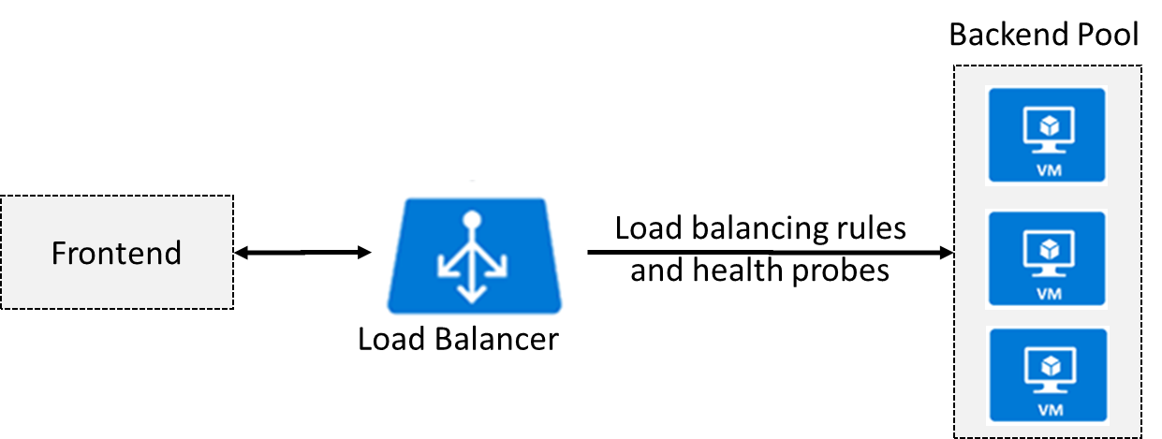
Azure Load Balancer
Distributes inbound traffic to backend resources using load-balancing rules and health probes
Can be used for both inbound/outbound scenarios
Protect on-premises web applications with secure remote access
Extend Active Directory to the cloud
Two types: Public and Internal
Notes:
✔ Keep this diagram in mind since it covers the four components that must be configured for your load balancer: Frontend IP configuration, Backend pools, Health probes, and Load balancing rules.
For more information, you can see:
Load Balancer documentation - https://docs.microsoft.com/en-us/azure/load-balancer/

Slide 75
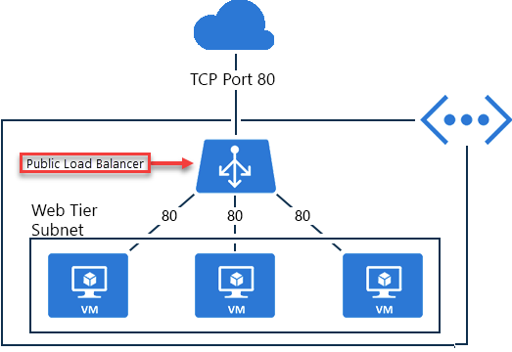
Public Load Balancer
Maps public IP addresses and port number of incoming traffic to the VM’s private IP address and port number, and vice versa.
Apply load balancing rules to distribute traffic across VMs or services.

Slide 76
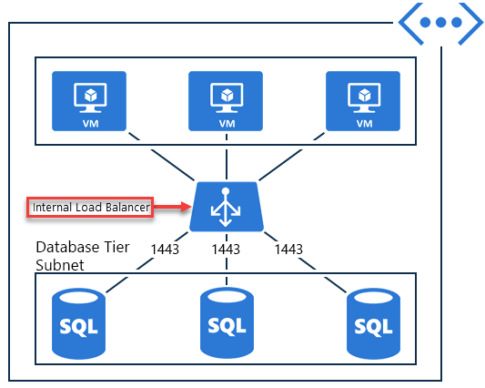
Internal Load Balancer
Directs traffic only to resources inside a virtual network or that use a VPN to access Azure infrastructure.
Frontend IP addresses and virtual networks are never directly exposed to an internet endpoint.
Enables load balancing within a virtual network, for cross-premises virtual networks, for multi-tier applications, and for line-of-business applications.
Notes:
✔ Can you see how a public load balancer could be placed in front of the internal load balancer to create a multi-tier application.

Slide 77
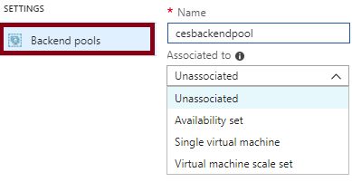
Backend Pools
SKU | Backend pool endpoints
Basic SKU | VMs in a single availability set or VM scale set.
Standard SKU | Any VM in a single virtual network, including a blend of VMs, availability sets, and VM scale sets.
To distribute traffic, a back-end address pool contains the IP addresses of the virtual NICs that are connected to the load balancer.
Notes:
✔ In the Standard SKU you can have up to 1000 instances in the backend pool. In the Basic SKU you can have up to 100 instances.

Slide 78
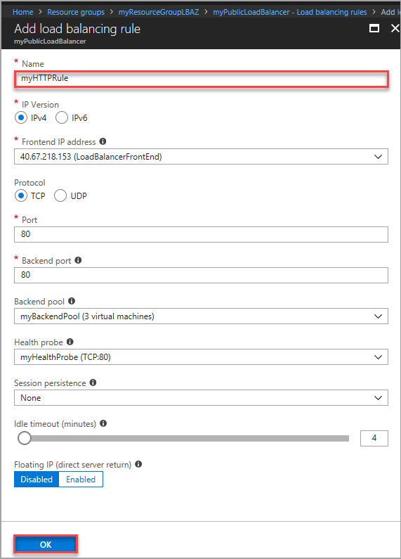
Load Balancer Rules
Maps a frontend IP and port combination to a set of backend IP addresses and port combination
Rules can be used in combination with NAT rules
A NAT rule is explicitly attached to a VM (or network interface) to complete the path to the target
Notes:
✔ Can you see the difference between load balancing rules and NAT rules? Remember, this approach should only be used when you need connectivity from the Internet. Most normal communications would occur from on-premises to Azure connections such as site-to-site VPN and ExpressRoute.

Slide 79

Using Floating IP with Clusters
Floating IP should be configured on LB Rule
Azure's terminology for a portion of what is known as Direct Server Return (DSR)
DSR consists of two parts:
a flow topology & IP address mapping scheme
The load balancing rule for a HANA cluster requires a floating IP, so the back-end port is the same as the front-end port
This means that the outbound part of a flow is always correctly rewritten to flow directly back to the origin
Notes:
https://docs.microsoft.com/en-us/azure/virtual-machines/workloads/sap/sap-hana-high-availability-rhel

Slide 80


Session Persistence
Session persistence specifies how client traffic is handled
Client IP (default) requests can be handled by any virtual machine
Client IP and protocol specifies that successive requests from the same address and protocol will be handled by the same virtual machine
Notes:
✔Keeping session persistence information is very important in applications that use a shopping cart. Can you think of any other applications?

Slide 81

Health Probes
Allows the load balancer to monitor the status of an app
Dynamically adds or removes VMs from the load balancer rotation based on their response to health checks
HTTP custom probe (preferred) pings every 15 seconds
TCP custom probe tries to establish a successful TCP session
Notes:
✔ There is also a guest agent probe. This probe uses the guest agent inside the VM. It is not recommended when HTTP or TCP custom probe configurations are possible. Relate back to the original diagram to ensure all the components are covered.

Slide 82
Hybrid-Cloud

Slide 83



Connectivity Options to Azure
Secure point-to-site connectivity
POC Efforts
Small scale deployments
Connect from anywhere
Connect to Azure compute from on-premises or another Azure region
Secure site-to-site
VPN connectivity
In-region VNet-to-VNet connectivity
Direct VM-to-VM connectivity
Peer VNets for routing and transit
VNet Peering
within region
Private connectivity from your on-premises data center to Azure virtual networks and PaaS Services
ExpressRoute private connectivity

Slide 84



Point to Site
Uses self-signed certificates for authentication
Allows individual computers to connect remotely to the Microsoft Azure Virtual Network using SSTP.
Use cases: secure remote development or administration
Virtual Network
Gateway IP: 104.141.24.71
Address Space: 172.16.0.0/20
VPN Clients
Address Space: 192.168.1.0/24
INTERNET
TLS
Gateway
GatewaySubnet
172.16.1.4
Gateway PIP
137.135.8.71
Laptop
192.168.1.5
WEB01
Subnet APP
172.16.2.4
WEB02
Subnet APP
172.16.2.5
MYSQL01
Subnet SQL
172.16.3.4

Slide 85



Site-to-Site VPN
VPN Tunnel used to connect On-Premises Networks with Virtual Networks in Azure
Local Site
Address Space: 10.0.0.0/8
Gateway IP: 75.4.85.104
Address Space
172.16.0.0/20
Address Space
10.0.0.0/8
On-Premises Firewall
Azure VPN Gateways
AD-DC-01
AD-DC-02
GW1
172.16.0.4
UBUNTU1
172.16.1.4
INTERNET
IKEv2
ASA
75.4.85.104
MYSQL1
172.16.2.4
GW1
172.16.0.5
UBUNTU2
172.16.1.5
Exchange
SharePoint
Subnet: Gateway
CIDR: 172.16.0.0/24
Subnet: APP
CIDR: 172.16.1.0/24
Subnet: DATA
CIDR: 172.16.2.0/24

Slide 86

VNET Peering
Connect two VNETs in the same region at wire speed
No routing configuration required, but can’t be overlapping IP Address space

Slide 87

VNet Peering
VNet peering connects two Azure virtual networks
Two types of peering: Regional and Global
Peered networks use the Azure backbone for privacy and isolation
Easy to setup, seamless data transfer, and great performance
Global peering has special requirements
Notes:
For more information, you can see:
Virtual network peering - https://docs.microsoft.com/en-us/azure/virtual-network/virtual-network-peering-overview

Slide 88

Site to Site VPN & Peering
Hybrid Cloud using VPN via the Internet
Two VNETs in the same region at wire speed

Slide 89
Demo VNET Peering
Notes:
Use the Azure Portal to Peer two of the networks together
Show how to “verify” using the portal to show they are “connected”

Slide 90

ExpressRoute
Extends on-premises networks into Microsoft cloud with dedicated private connections
Excellent for data migration, business continuity, and disaster recovery
Cost-effective option for transferring datasets
Adds high throughput and fast latency capacity to your datacenter
Notes:
For more information, you can see:
ExpressRoute - https://azure.microsoft.com/en-us/services/expressroute/

Slide 91

ExpressRoute Capabilities
Layer 3 connectivity with redundancy
Connectivity to all regions within a geography
Global connectivity with ExpressRoute premium add-on
Across on-premises connectivity with ExpressRoute Global Reach
Bandwidth options – 50 Mbps to 10 Gbps
Billing models – unlimited, metered, premium

Slide 92

ExpressRoute Redundancy

Slide 93
Discussion Point
Why do you think customers would choose ExpressRoute over other means to connect their networks to Azure?

Slide 94
Azure Resource Manager

Slide 95




Azure Resource Manager
Enable application management within Azure
Support lifecycle management with integrated Role Based Access Control (RBAC)
Templatize application deployment and configuration, supports DevOps

Slide 96
Organize
Resource Groups
Tag resources with meta-data, allows for detailed billing
One Click Delete resources, including across regions
RESOU
R
CE G
R
OUP

Slide 97
Resource Group Rules
Resources can only exist in one resource group
Groups cannot be renamed
Groups can have resources of many different types (services)
Groups can have resources from many different regions
Deployments are *incremental*

Slide 98



Control
Manage Permissions by defining Roles
Apply locks to critical resources, preventing accidental changes or deletions
Log & audit all user actions

Slide 99

Locks
Used to prevent accidental deletion
Scope
Subscription
Resource Group
Resource
Types:
Read Only - authorized users can't delete or modify a resource
CanNotDelete - authorized users can change but not delete a resource
Locks are inherited by child resources

Slide 100
Identity & Security

Slide 101


Azure Active Directory & RBAC
Azure Resources
Authentication
& Authorization
Users
Groups
Subscription
Resource
Groups
Resources
Service Principals
Azure Active Directory
Azure Subscription

Slide 102







One identity and access management
Single sign on to any app anywhere
Secure user credentials
Collaborate with customers and partners
Accelerate adoption of your apps
Microsoft Azure
Active Directory
Azure AD Connect
On-premises /
Private cloud
Notes:
The first thing you need to do is to connect your on-premises Active Directory to the cloud with Azure AD Connect. Azure AD Connect is the Microsoft tool designed to meet and accomplish your hybrid identity goals. This allows you to provide a common identity for your users for Office 365, Azure, and SaaS applications integrated with Azure AD. At its core, it enables synchronization between on-premises and cloud identity infrastructures. Specifically, it creates users, groups, and other objects and ensures data is consistent between directories. Once user data is extended with the sync engine, the next consideration is a secure method to authenticate users.
App Proxy lets you use Azure AD as your authentication and authorization service for your on-premises apps as well as your cloud apps. This lets users who are remote from your business to get back to on-premises apps that are claims aware. We’ll use lightweight connectors in your firewall to do this, which lets you expose just the apps you want a user to get into out wherever they are out in the world while applying all of your common policies and security posture to them, without having to open up a VPN.
And let’s be real, VPNs are scary. Most corporate hacks start by compromising a user account, and then immediately heading to a VPN. And once I’m on your VPN, I’m in the network and I can take over pretty much whatever I want.
Accelerate adoption of your apps. As organizations move their identity systems to the cloud, you need applications that you use and develop to integrate with your enterprise identity system. With Azure AD your platform, it provides a tremendous opportunity for developers to integrate into this ecosystem.

Slide 103

Extending Identity to Azure
Synchronize on-premises AD with Azure AD using AD Connect
Provides single sign on access to migrated apps and Internet SaaS apps
Use ADFS or Passthrough authentication for Enterprises
Notes:
Context
Identity and networking come up often in my customer conversations. These are a key set of foundational capabilities that you need to invest in, as you scale up your migration efforts.
What’s needed
You need a common identity infrastructure which can help you quickly establish single sign on access to your migrated resources. And for apps/workloads that are distributed across Azure and onprem, you need secure, dedicated connectivity to ensure QoS needs are met.
Our solution
Scenario 1 (optimized for single sign on):
Use Azure AD to create an Active Directory domain in the cloud and connect it to your on-premises Active Directory domain. Azure AD Connect integrates your on-premises directories with Azure AD. Azure AD Connect will integrate your on-premises directories with Azure Active Directory. This allows you to provide a common identity for your users for Office 365, Azure, and SaaS applications integrated with Azure AD.
Scenario 2 (optimized for high performance integration between Azure and onprem workloads):
Extend your existing on-premises Active Directory infrastructure to Azure, by deploying a VM in Azure that runs AD DS as a domain controller. This architecture is more common when the on-premises network and the Azure virtual network (VNet) are connected by a VPN or ExpressRoute connection.
https://docs.microsoft.com/en-us/azure/architecture/reference-architectures/identity/

Slide 104

User Accounts
All users must have a user account
The account is used for authentication and authorization
Identity Sources: Cloud, Directory-synchronized, and Guest
Notes:
✔️ Have you given any thought as to the type of users you will need?

Slide 105

Group Accounts
Security groups
Distribution groups
Directly assigned
Dynamically assigned
New-AzADGroup -Description "Marketing" -DisplayName "Marketing" -MailEnabled $false -SecurityEnabled $true -MailNickName "Marketing"
Notes:
✔️ Have you given any thought to which groups you need to create? Would you directly assign or dynamically assign membership?

Slide 106



Role Assignment
Users
Assigned to organizational users in the AD associated with the subscription
Or, external Microsoft accounts in the same directory
Groups
Assigned to Azure AD security groups
Best practice: manage access through groups, adding roles, and assigning users
Service Principals
Service identities represented as service principals in the directory
Authenticate with Azure AD and securely communicate with one another

Slide 107

RBAC Roles
Owner can manage everything, including access
Contributors can manage everything except access
Readers can view everything but can't make changes

Slide 108



RBAC Scopes & Inheritance
Subscription
Owner
Contributor
Reader
Resource
Groups
Access is Inherited
Owner
Contributor
Reader
Resources
Web
SQL
VM
NIC
Disks
Owner
Contributor
Reader

Slide 109
Multi-Factor Authentication
Any two or more of the following:
Something you KNOW: Password or a PIN-code
Something you HAVE: Phone, Credit Card, Token,…
Something about YOU: Fingerprint, Iris scan,…
01234
Notes:
Multi-Factor Authentication offers the additional security you demand using the phones your users already carry. Multiple phone-based authentication methods are available, allowing users to choose the one that works best for them. And, support for multiple methods ensures additional authentication is always available.
Multi-Factor Authentication apps are available for Windows Phone, iOS phones and tablets, and Android devices. Users download the free app from the device store and activate it using a code provided during set up. When the user signs in, a notification is pushed to the app on their mobile device. The user taps to approve or deny the authentication request. Cell or Wi-Fi access is required. For offline authentication, the app works like a software token to generate a one-time passcode that is entered during sign in. The one-time-passcode method is comparable to software or soft tokens solutions offered by vendors like RSA and Gemalto.
Automated phone calls are placed by the Multi-Factor Authentication service to any phone, landline or mobile. The user simply answers the call and presses # on the phone keypad to complete their sign in.
Text messages are sent by the Multi-Factor Authentication service to any mobile phone. The text message contains a one-time passcode. The user is prompted to either reply to the text message with the passcode or enter the passcode into the sign in screen.

Slide 110

Conditional Access - Requiring MFA
Conditions – “When this happens”
Access controls – “Then do this”
Lets you enforce controls on access to apps based on specific conditions
The combination of your conditions with your access controls represents a conditional access policy
Notes:
✔️ Do you think conditional access would be something your organization is interested in?

Slide 111


Cloud Native Security
Protect & Detect threats against Cloud & On-Premises deployments
Security Center
Sentinel
Unified security management
Advanced threat protection across hybrid cloud workloads
AI driven Security Information and Event Management (SIEM)
Detect threats early with unique intelligence
Notes:
Improved security and compliance (SGX, Azure Sentinel for SEIM, Blueprint etc)

Slide 112



Continuous Security
Azure Security Center
Gain full visibility and control of your cloud security state
Leverage ML to Proactively identify and mitigate risks to reduce exposure to attacks
Quickly detect and respond to threats with advanced analytics
Notes:
Just because you’re moving fast, doesn’t mean you have to lose control – even if you have some Shadow-Ops happening
Azure security gives you visibility and control of your entire cloud security state
Using analytics to provide pro-active recommendations across both Windows and Linux
Leverage services like Azure Event Viewer also to track access, see who change what and when.
------ (additional product context) ------
Secure your cloud resources with Azure Security Center
With Azure Security Center you can gain full visibility and control of your cloud security state with a single, unified view:
Collect security data from multiple sources: Collect, search, and analyze security data from a variety of sources, including connected partner solutions like network firewalls and other Microsoft services.
Integration with existing security workflows: Access, integrate, and analyze security information using REST APIs to connect existing tools and processes.
Easily onboard cloud resources: Keep pace with rapidly changing cloud workloads. Automatically discover and onboard new resources created in your Azure subscriptions.
Continuous security assessment: monitor the security of virtual machines, networks, and Azure services using hundreds of built-in security assessments or create your own.
Built-in dashboards provide instant insights into security issues that require attention.
Centralized policy management: Ensure compliance with company or regulatory security requirements by centrally managing security policies across all your cloud workloads.
Compliance reporting: Use security data and insights to demonstrate compliance and easily generate evidence for auditors.
(If asked whether Azure Security Center supports hybrid workloads, the answer is yes: manage security across all your hybrid cloud workloads – on-premises, Azure, and other cloud platforms – in one console.)
You can also identify and mitigate risks proactively to reduce your exposure to security threats:
Proactive security assessment: Identify software and configurations that are vulnerable to attack.
Actionable recommendations: Remediate security vulnerabilities before they can be exploited by attackers with prioritized, actionable security recommendations and built-in automation playbooks.
Adaptive application controls: Block malware and other unwanted applications by applying whitelisting recommendations adapted to your specific workloads and powered by machine learning.
Controlled network access: Reduce the network attack surface with just-in-time, controlled access to management ports on Azure VMs, drastically reducing exposure to brute force and other network attacks.
Azure Security Center has robust capabilities to prevent attacks. When threats do happen, Security Center can quickly detect and respond to threats with advanced analytics and Microsoft Intelligent Security Graph.
Industry’s most extensive threat intelligence: Tap into the Microsoft Intelligent Security Graph, which uses trillions of signals from Microsoft services and systems around the globe to identify new and evolving threats.
Advanced threat detection: Use built-in behavioral analytics and machine learning to identify attacks and zero-day exploits. Monitor networks, machines, and cloud services for known attack patterns and post-breach activity.
Prioritized alerts and incidents: Focus on the most critical threats first with prioritized security alerts and incidents that map alerts of different types into a single attack campaign. Create your own custom security alerts as well.
Streamlined investigation: Quickly assess the scope and impact of an attack with a visual, interactive experience. Use predefined or ad hoc queries for deeper exploration of security data.
Contextual threat intelligence: Visualize the source of attacks on an interactive world map. Use built-in threat intelligence reports to gain valuable insight into the techniques and objectives of known malicious actors.
At Microsoft, we analyze 300 billion user authentications and check 200 billion emails for spam and malware monthly. We also have unprecedented visibility into cloud infrastructure choices, platforms and the activity therein. Such visibility has no precedent in the on-premises world.

Slide 113



Azure Security Center
Protecting Windows Server in Azure
System update status
Antimalware protection
OS & web server config
Disk encryption
Notes:
Link to update management https://docs.microsoft.com/en-us/azure/automation/automation-update-management
Remove update issues with on-

Slide 114

Azure Security Center
Just-in-time Access to Windows Server in Azure
Protect against brute force attacks
VMs locked down at the network level
Upon request Security Center automatically reconfigures Network Security Groups (NSGs) to allow inbound traffic
After a time period restores NSGs

Slide 115

Azure Sentinel
Cloud Scale Security Event Information Management (SEIM) for On-Premises & All Clouds
Collect Data at Cloud Scale
Detect previously uncovered threats an minimize false positivizes
Investigate threats with AI tapping into decades of cybersecurity work at Microsoft
Respond to incidents rapidly with automation
Notes:
https://docs.microsoft.com/en-us/azure/sentinel/connect-windows-security-events

Slide 116

Azure Sentinel
Protecting Windows using Security Event Information Management (SEIM)
Security Events
System Logs
Windows Firewall
Traffic Analysis
Notes:
https://docs.microsoft.com/en-us/azure/sentinel/connect-windows-security-events

Slide 117





Governance for the Cloud
NEW
NEW
NEW
Management Group
Policy
Blueprints
Resource Graph
Cost Management
Define organizational hierarchy
Real-time enforcement, compliance assessment and remediation
Deploy and update cloud environments in a repeatable manner using composable artifacts
Query, explore & analyze cloud resources at scale
Monitor cloud spend and optimize resources
Hierarchy
Control
Environment
Visibility
Consumption
Notes:
Improved security and compliance (SGX, Azure Sentinel for SEIM, Blueprint etc)

Slide 118
Business Continuity Disaster Recover

Slide 119


Disaster Recovery to/for the Cloud
VMware
Hyper-V
Physical
Failover from your data center
Failover between regions in Azure

Slide 120
Azure Site Recovery
Site Recovery helps ensure business continuity by keeping business apps and workloads running during outages
Site Recovery replicates workloads running on physical and virtual machines (VMs) from a primary site to a secondary location.
When an outage occurs at your primary site, you fail over to secondary location, and access apps from there.
After the primary location is running again, you can fail back to it.

Slide 121

Azure Site Recovery

Slide 122

Replicate Azure VMs with Azure Site Recovery
No DR infrastructure
Automated protection and replication
Best-in-class RPO and RTO
No-impact DR drills
Orchestrated recovery plans for application-aware recovery
Failback support
Centralized monitoring and alerting

Slide 123

Azure Site Recovery (ASR) Scenarios
Replicate Azure VMs from one Azure region to another
Replicate on-premises VMware VMs, Hyper-V VMs, physical servers (Windows and Linux), Azure Stack VMs to Azure
Replicate on-premises VMware VMs, Hyper-V VMs managed by System Center VMM, and physical servers to a secondary site
Notes:
We will concentrate on replication within Azure and not migration scenarios from on-premises.

Slide 124



Achieve Near-zero Application Data Loss
Periodic DR Testing
Invoke
BCP
Take App Offline
Failover to Azure
Resume
App

Slide 125





Typical SharePoint Application High availability mode
Availability Set
Multi-tiered with Availability Set
Load balancers
Public IP connectivity
SQL Always On
Web1
Web2
Availability Set
AD1
AD2
App1
App2
Availability Set
SQL1
SQL2

Slide 126




Application-aware Recovery
Enable Replication
Availability Set
Failover
Availability Set
Web1
Web2
Web1
Web2
AD-DR
Availability Set
Availability Set
App1
App2
AD1
AD2
App1
App2
Availability Set
SQL1
SQL2
SQL-AG

Slide 127


Disaster Recovery for Hyper-V
Hyper-V Server
Azure Site Recovery
443 (HTTPS)
Data Channel
Public Internet or ExpressRoute with Public Peering
Source: Hyper-V
Microsoft Azure Recovery Services Agent
Replicates data to Azure
Documentation: https://aka.ms/asr_hyperv
Videos: https://aka.ms/asr_videos

Slide 128
Disaster Recovery for VMware
443 (HTTPS)
Config Server
Process Server
9443 (HTTPS)
Azure Site Recovery
443 (HTTPS)
Data Channel
Public Internet or ExpressRoute with Public Peering
Source: VMware, AWS & Physical Servers
Process Server
Used for caching, compression, and encryption
Configuration Server
Used for centralized management
Mobility Service Captures all data writes from memory
Documentation: http://aka.ms/asr_vmware
Videos: https://aka.ms/asr_videos

Slide 129

Azure Backup
First party SaaS service running in public Azure
Backs up Windows Server VMs, Physical and IaaS VMs to Azure
Supports file/folder, VMs (Windows) On-Premises
Flexible long term retention policy

Slide 130
Azure Recovery Services Vault
A storage entity in Azure that houses data.
Data is typically copies of data, or configuration information for virtual machines (VMs), workloads, servers, or workstations.
Also backup data for various Azure services such as IaaS VMs (Linux or Windows) and Azure SQL databases.
Supports System Center DPM, Windows Server, Azure Backup Server, and more.

Slide 131


Recovery Services Vault Backup Options
Azure Workloads
On-Premises workloads
Notes:
Focus on the choices when you select Azure or On-Premises and want to backup files and folders.
✔️ Within an Azure subscription, you can create up to 25 Recovery Services vaults per region.
✔️ Notice your backup choices for virtual machines. This will be covered in another lesson.

Slide 132
Discussion Point
How does the Cloud change the cost of DR?
Do you think it would be possible to get to a cost breakdown of monthly to protect and hourly to failover?
Who shouldn’t have a DR Plan?

Slide 133

Whiteboard Design Session
Microsoft Cloud Workshop: Building a Resilient IaaS Architecture
Design and use resiliency concepts
High Availability with protection from hardware failures using Availability Sets
High Availability and Disaster Recovery for database tiers using SQL Always On
Disaster Recovery for VMs using Azure Site Recovery and multiple Azure Regions

Slide 134
Team Challenge
Microsoft Cloud Workshop: Building a Resilient IaaS Architecture
Break into Teams of #
Create Teams Channel (Chat + Screen Share)
Rotate Keyboard Leader for each Exercise
Everyone participate and collaborate to complete all exercises
http://bit.ly/2IDDudp
Notes:
https://github.com/Microsoft/MCW-Building-A-Resilient-IaaS-Architecture

